Slide 1


Shri Ramdeobaba College of Engineering & Management, Nagpur
Department of Computer Science & Engineering(AIML)
Session 2023-2024
SEMINAR
ON
SymptoSense – NLP based Symptom Classifier
Guided By : Dr. Amit Pimpalkar
Presented By :
Shreyas Raut
Samiran Gupta
Shubham Shivhare
Vedant Waghale

Slide 2
Content
Introduction
Motivation
Objectives
Literature Survey
Proposed Plan of Work(Flow chart, use case diagram)
Model overview
Technology
Expected Outcome
References

Slide 3
INTRODUCTION​
The disease is an abnormal condition of parts of the body or mind of humans.
SYMPTOM CLASSIFIER
STREAMLINE SYMPTOM ANALYSIS
DIAGNOSTIC ACCURACY
TREATMENT PLANNING

Slide 4
MOTIVATION
The need is to efficiently process patient-reported symptoms, which help for prioritizing cases, to enhance diagnostic accuracy, to facilitate remote healthcare, and to improve clinical decision-making.
To provide healthcare professionals with comprehensive and organized symptom profiles, facilitating targeted and effective treatment strategies.

Slide 5
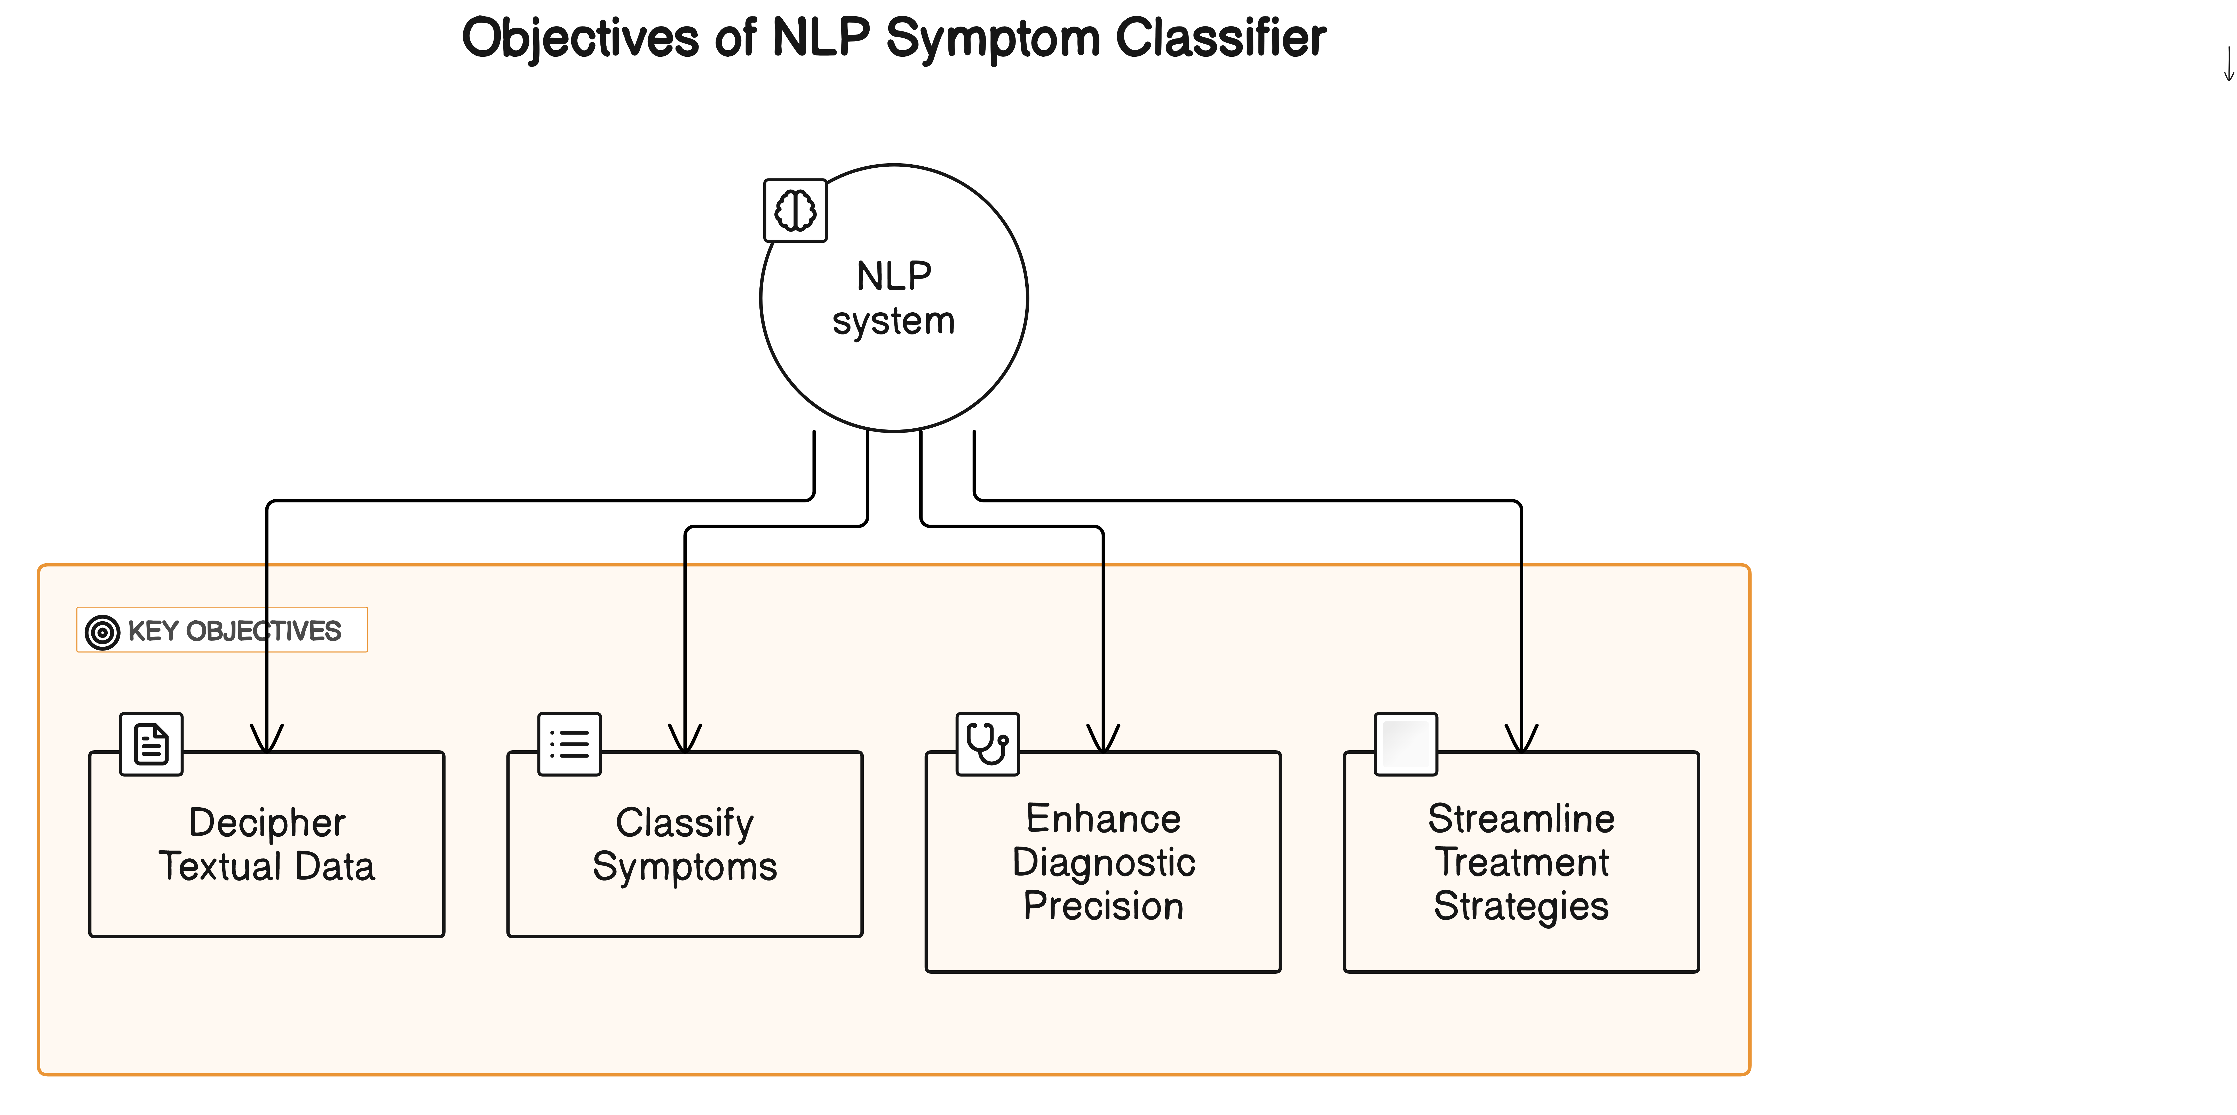
OBJECTIVES

Slide 6
LITERATURE SURVEY​
Sr no. | Title | Approach/Model/Algorithm | Formula used | Source/Dataset | Findings and Relevance ,accuracy | Research Gap /Limitation
1 | Symptom Identification in Electronic Health Records using NimbleMiner: A Natural Language Processing Approach | The approach leverages NimbleMiner, an open-source NLP RStudio Shiny application, which integrates word embedding techniques like word2vec for language modeling and phrase2vec for feature extraction. The algorithm utilizes random forest classifiers for predicting symptom concepts in clinical notes. | Performance metrics such as recall, precision, and F-measure are calculated using standard formulas to assess the accuracy of symptom identification. | The dataset comprises clinical notes from a single medical centre, encompassing various note types authored by nurses and physicians. The data are preprocessed and annotated to create a gold standard for evaluating the performance of NimbleMiner. | NimbleMiner achieves strong performance in identifying symptoms from clinical text data, with F-measure scores ranging from 0.80 to 0.96 for different symptom concepts. The system's ability to accurately extract symptom information from electronic health records demonstrates its potential utility in improving clinical decision-making and patient care. | The study's primary limitation lies in the restricted generalizability of findings due to the utilization of data from a single medical center. Additionally, the evaluation focuses on a subset of symptom concepts and may not fully represent the diverse range of symptoms encountered in clinical practice. Further research is needed to assess NimbleMiner's performance across multiple healthcare to address these gaps.

Slide 7
Sr no. | Title | Approach/Model/Algorithm | Formula used | Source/Dataset | Findings and Relevance ,accuracy | Research Gap /Limitation
2 | Limitations of Transformers on Clinical Text Classification Shang Gao , Mohammed Alawad, M. Todd Young , John Gounley , Noah Schaefferkoetter, Hong Jun Yoon , Xiao-Cheng Wu, Eric B. Durbin , Jennifer Doherty , Antoinette Stroup , Linda Coyle, and Georgia Tourass | The work discusses using BERT for document classification tasks in the context of clinical text. Due to resource constraints, they utilize BlueBERT pretrained on PubMed abstracts and clinical notes. Another model introduces to CNN for biomedical and clinical text classification. This CNN architecture processes documents using word embeddings and parallel 1D convolution layers, followed by max pooling to generate document vectors for classification. | An equation from an attention mechanism, likely used in a neural network architecture, n this formula, K = EW^k + b^k, V = EW^v + b^v K and V represent the keys and values, respectively, which are learned representations of input data And weight matrices W^k and W^v, along with bias terms bk and bv. | MIMIC-III Discharge Summaries Dataset: This dataset contains unstructured clinical notes and structured tables from nearly 50,000 hospital admissions at Beth Israel Deaconess Medical Center. SEER Cancer Pathology Reports Dataset: This dataset includes over 1.2 million cancer pathology reports from multiple SEER cancer registries. | The results of experiments on the MIMIC-III dataset are presented. Initially, the performance of each model is evaluated when restricted to the first 510 WordPiece tokens, which is approximately 400 word tokens per document. For BERT precision is about 62%, for CNN with 510 tokens precision is about 68% and for CNN precision is about 73%. | This study compares BERT adaptation methods with CNN and HiSAN on clinical text classification tasks. Results show BERT performs equally or worse than baselines. Possible reasons include low signal-to-noise ratio and BERT's tokenizer complexity. While simpler models may suffice, recent advancements in BERT adaptation show promise.

Slide 8
Sr no. | Title | Approach/Model/Algorithm | Formula used | Source/Dataset | Findings and Relevance ,accuracy | Research Gap /Limitation
3 | Automated Extraction of Pain Symptoms: A Natural Language Approach using Electronic Health Records Amisha D. Dave, BSE1 , Gualberto Ruaño, MD, PhD1,2, Jonathan Kost, MD3 , and Xiaoyan Wang, PhD. | The JDH EHR dataset contains 611,355 clinical narratives from 359,854 patients from diverse demographic backgrounds. Training set of 100 notes annotated based on focus group generated ontology to generate and evaluate an NLP model further tested on the remaining notes. A word2vec query expansion algorithm was implemented to identify the pain cohort. These notes were simultaneously run using the trained CLAMP model.. | Precision, recall, and F1 measure are mentioned as metrics to assess the performance of the NLP pipeline. Recall = TP/(TP+FN) Precision = TP/(TP+FP) F1 score = 2*(P*R)/(P+R) These metrics are commonly used in evaluating the performance of classification models, including those used in Natural Language Processing tasks, to assess the accuracy and effectiveness of the model | The dataset sourced from UConn Health John Dempsey Hospital Electronic Health Records, covering around 600,000 de-identified patients from 2015 to 2019. Using a word2vec query expansion algorithm, It comprises 611,355 clinical notes capturing various aspects of pain experiences. These notes serve as a rich source for training the NLP model, ensuring patient privacy through de-identification measures. | Prevalent body locations like back, knee, and shoulder, along with common symptoms such as decreased mobility and back pain, were identified. Noteworthy pain descriptors include radiation and numbness. The distribution of pain quantity indicated a frequent rating of 8/10. Internal validation showcased the NLP model's strong performance in identifying key pain-related parameters. The findings are relevant for improving clinical understanding, aiding diagnosis. | Additional work in this study will focus on improving the NLP model to accurately This can be done by building upon the ontology developed in this study to capture deeper relationships between entities. to make use of the CUI code feature present within the NLP software to allow for better categorization of notes. EHRs, we can bring these costs down by decreasing the number of follow-up appointments to adjust treatment regimens.

Slide 9
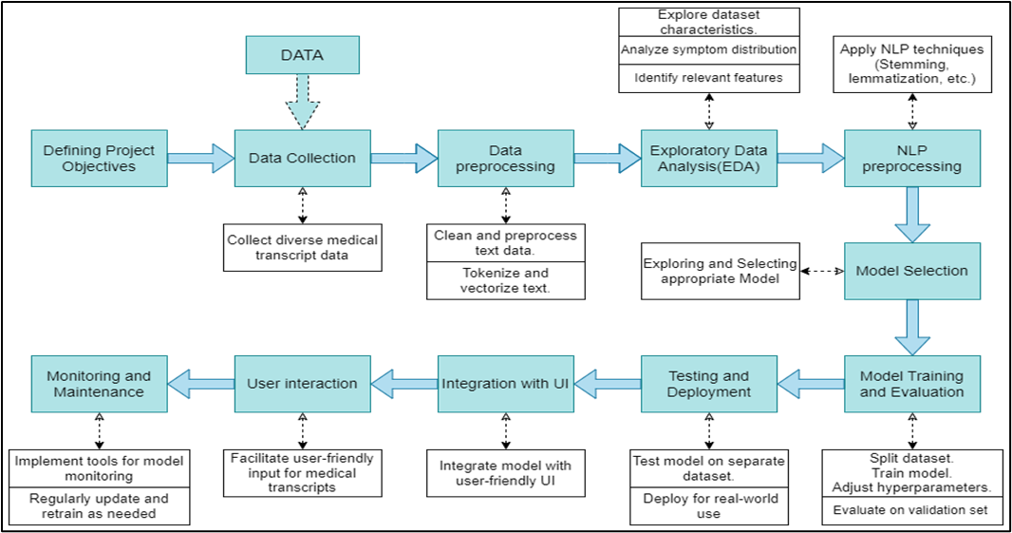
WORKFLOW

Slide 10
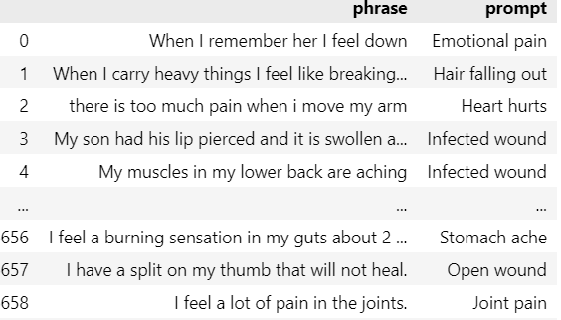
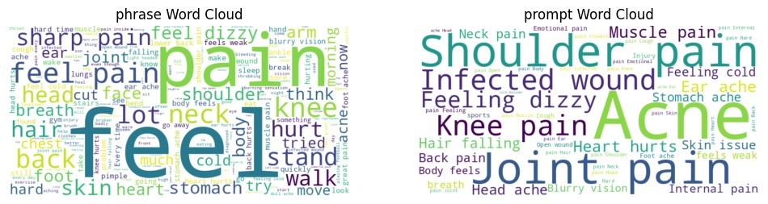
Dataset Overview

Slide 11
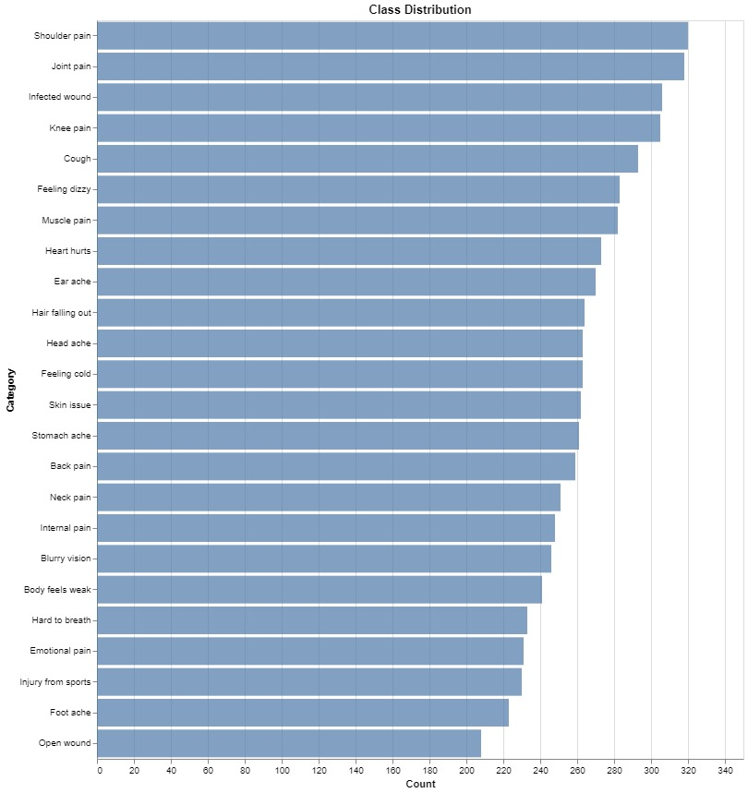
Class Distribution

Slide 12
Observations:
Loss function anything other than categorical_crossentropy or sparse_categorical_crossentropy will give error.
Output layer Activation should be softmax as it is a multiclass data.
(Sigmoid activation will also give output but it will be misleading as it is used specifically for binary classification.)
Model 1 using wordnet and LSTM:
 | Optimizer | Loss Function | Encoding Type | Test Loss | Accuracy
1 | Adam | categorical_crossentropy | One-hot | 0.030144 | 99.474871
2 | Adam | categorical_crossentropy | Two-hot | 0.077535 | 98.724681
3 | RMSProp | categorical_crossentropy | One-hot | 0.123513 | 97.974491
Model 2 using GloVe (ANN):
 | Optimizer | Loss Function | Encoding Type | Test Loss | Accuracy
1 | Adam | sparse_categorical_crossentropy | Label Encoder | 0.024434 | 99.70
2 | Adagrad | sparse_categorical_crossentropy | Label Encoder | 0.159308 | 99.249809
3 | RMSProp | sparse_categorical_crossentropy | Label Encoder | 0.026784 | 99.699926

Slide 13



TECHNOLOGY
DATA PROCESSING
STACK
NumPy , PANDAS
Data manipulation and analysis.
Tensorflow, Keras
ANN Model development
NLTK
NLP toolkit for text preprocessing
Google Colab/Kaggle:
For GPU acceleration
GitHub
Collaboration with team
NLP tools like
LSTM, GloVe, BERT etc

Slide 14
EXPECTED OUTCOME
It features a user-friendly interface for easy input of symptoms.
The system accurately identifies and analyzes symptoms described in user-inputted text.
The system enhances clinical decision making by providing valuable insights and healthcare support to professionals.
It effectively classifies analyzed text into appropriate medical condition or categories.

Slide 15
SUMMARY :
Develop a system for analyzing and categorizing user inputted medical symptoms to aid healthcare professionals.
Implement a user-friendly interface for easy symptom input and quick feedback on potential medical conditions.
The system ais to enhance patient care outcomes and optimize clinical workflows by providing valuable insights to healthcare proffesionals.

Slide 16
REFERENCES
A. D. Dave, G. Ruano, J. Kost, and X. Wang, “Automated Extraction of Pain Symptoms: A Natural Language Approach using Electronic Health Records,” Pain Physician, vol. 25, no. 2, pp. E245–E254, Mar. 2022, Available: https://pubmed.ncbi.nlm.nih.gov/35322976/
T. A. Koleck et al., “Identifying Symptom Information in Clinical Notes Using Natural Language Processing,” vol. 70, no. 3, pp. 173–183, May 2021, Available: https://www.ncbi.nlm.nih.gov/pmc/articles/PMC9109773/
Shang Gao , Mohammed Alawad, M. Todd Young , John Gounley ,"Limitations of Transformers on Clinical Text Classification " , vol. 25, no. 9, September 2021 ,
Availiable : https://pubmed.ncbi.nlm.nih.gov/33635801/
Dataset
“Medical Speech, Transcription, and Intent,” www.kaggle.com. https://www.kaggle.com/datasets/paultimothymooney/medical-speech-transcription-and-intent

Slide 17
Thank You

